Slide 1
University of Rhode Island
SUMMER INTERNSHIP 2009
Oversize/Overweight Vehicle Routing and Permitting
with a Geographic Information System
Liza X. Rios Berrios

Slide 2

Agenda
Permitting Routing
  Definition
  Permits Type
  Permitting Process
Project Purpose
  Proposed Solution
GIS
  Definition
  Functions
  Benefits
  Software Overview
University of Rhode Island
Oversize/Overweight Vehicle Routing and Permitting
with a Geographic Information System
Department of Civil and Environmental Engineering

Slide 3
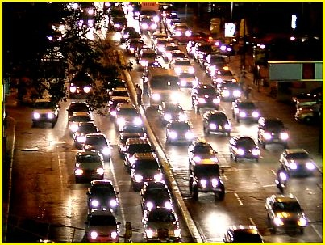

Introduction
In the United States many bridges are structurally deficient or functionally obsolete. In Rhode Island:
    53% bridges are structurally deficient or functionally obsolete
    48% roadways are deficient
    Truck travel rate increase
    There isn’t the monetary capacity to repair all
    Oversize/Overweight increase the
    problem
  Values taken from the ACSE 2005 infrastructure report card
University of Rhode Island
Oversize/Overweight Vehicle Routing and Permitting
with a Geographic Information System
Department of Civil and Environmental Engineering

Slide 4


Slide 5
Permits
The state permits and routes OS/OW vehicles in order to prevent bridge and roadway damage, limiting the path across the routes that could be affected by weight or size.
University of Rhode Island
Oversize/Overweight Vehicle Routing and Permitting
with a Geographic Information System
Department of Civil and Environmental Engineering

Slide 6
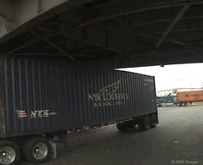
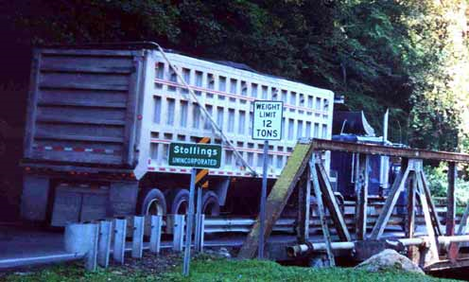
Permitting
When is a permit required?
  The permit is required when any vehicle or combination of vehicles exceed the legal limits specified in the General Law of Rhode Island
Source:http://www.silive.com/news/index.ssf/
Source:http://www.ohvec.org/issues/overweight
University of Rhode Island
Oversize/Overweight Vehicle Routing and Permitting
with a Geographic Information System
Department of Civil and Environmental Engineering
Notes:
Permits provide:
Safety to motorists driving along side os/ow vehicles.
Greatly reduce the possibility of over height collisions with objects (i.e. bridges, traffic signals, signs)
Prevent damage to state roadways and bridges
Inform carriers of necessary routing provisions

Slide 7
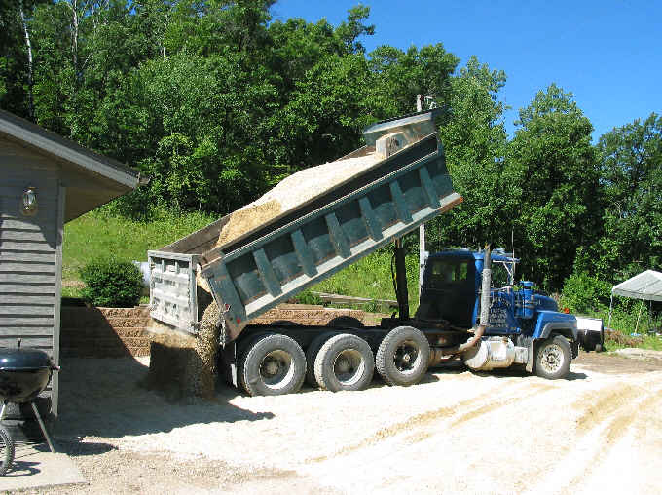
Permits Type
Single Permit
Divisible Permit
University of Rhode Island
Oversize/Overweight Vehicle Routing and Permitting
with a Geographic Information System
Department of Civil and Environmental Engineering
Notes:
Single Trip Permit: most common in Rhode Island and are issued for a specific move of a vehicle on a specified route.
Divisible Permit: issued for any load which can be reduced in dimensions to fit the specified limits for the state.

Slide 8
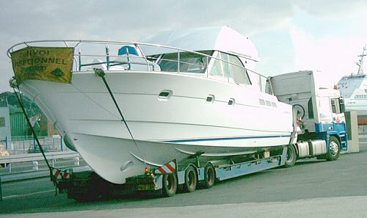
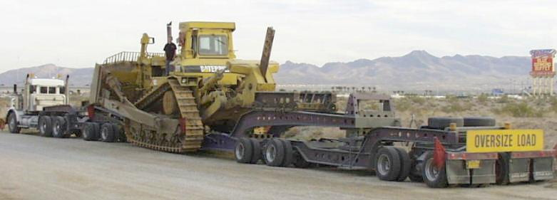
Permits Type
Blanket permit
Non-Divisible Permit
Blanket: http://www.accordoverseas.com/boat-rv-shipping.htm
University of Rhode Island
Oversize/Overweight Vehicle Routing and Permitting
with a Geographic Information System
Department of Civil and Environmental Engineering
Notes:
Blanket Permits: intrastate movement of an oversize vehicle for multiple trips on a single route over a period of time.
Non-divisible Permit: issued for vehicles which may have an excessive weight, height, length, or width and the load cannot feasibly or economically be reduced.

Slide 9
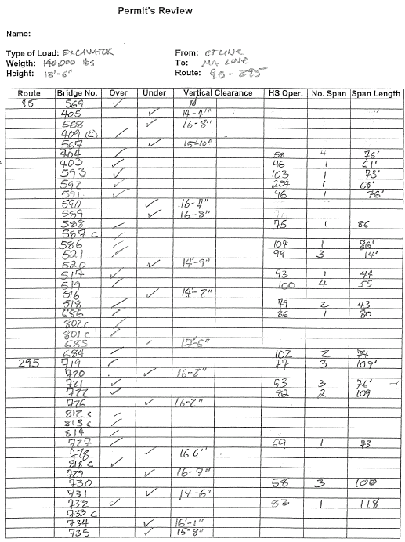
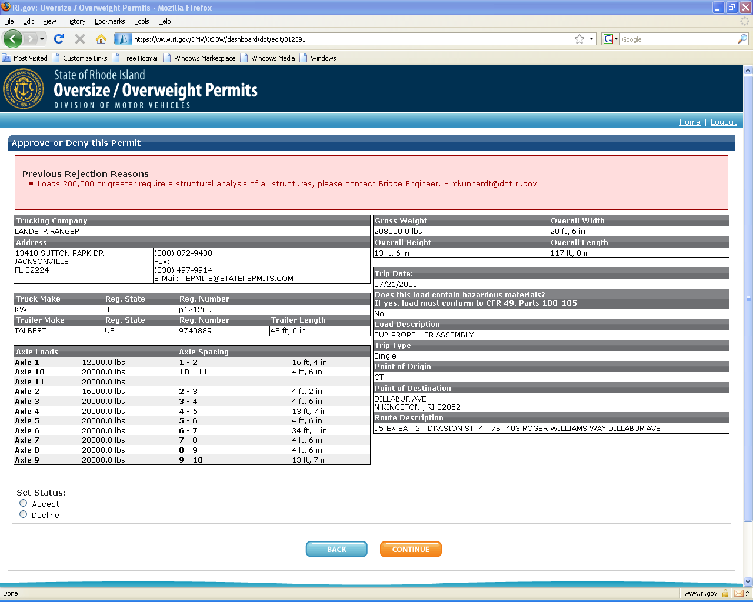
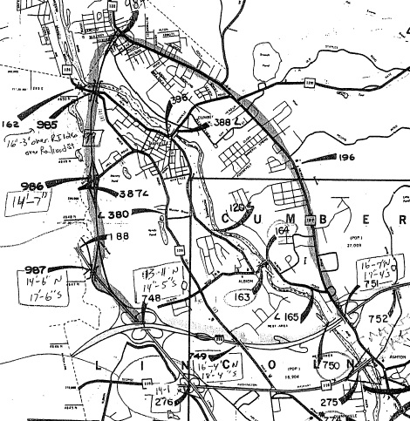
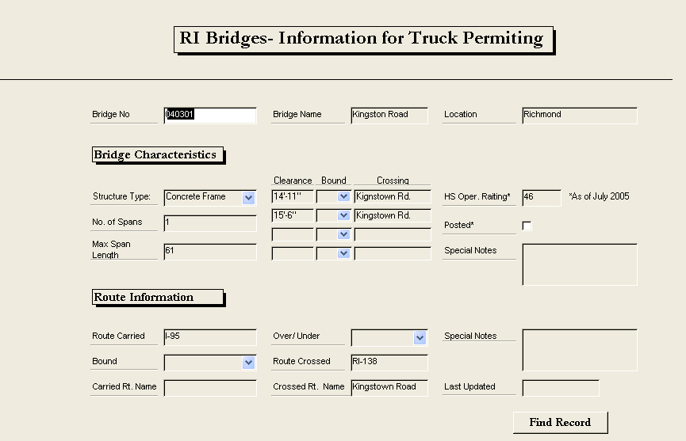
Permitting Process
Approval
YES
approval all restriction
RIDOT
NO
NO
Carriers submits trucks data
RIDMV
< 80,000 lb
<13’6’
Reject
YES
Accept
Source: The Use of a Geographic Information System for the Issuance of Oversize and Overweight Vehicle Permits
Mayrai Gindy & Andrew Prezioso
University of Rhode Island
Oversize/Overweight Vehicle Routing and Permitting
with a Geographic Information System
Department of Civil and Environmental Engineering
Notes:
Mas de 60,000 annuals
Data goes to RIDM

Slide 10

Purpose
The purpose of this project is to:
  Automate the OS / OW permitting and vehicle routing system
  Help the Rhode Island state economy
  Assist the Department of Transportation to provide the best customer service
University of Rhode Island
Oversize/Overweight Vehicle Routing and Permitting
with a Geographic Information System
Department of Civil and Environmental Engineering

Slide 11
Proposed Solution
The proposed solution is to create automated OS/OW routing in order to:
  Save cost
  Save time in the approval process
  Improve customer services
  Reduce taxpayer costs for routing vehicles
  Reduce human error
Integrating GIS software to analyze the permit routing in an automatic form
University of Rhode Island
Oversize/Overweight Vehicle Routing and Permitting
with a Geographic Information System
Department of Civil and Environmental Engineering

Slide 12
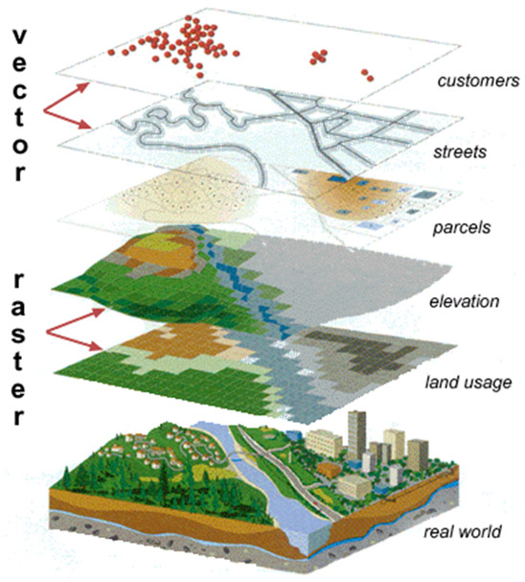
Geographical Information System
Storage, retrieval, mapping and analysis of geographic data.
Data is stored in coordinate form.
Same coordinate system can be layered together for mapping analysis.
Source: http://www.ncddc.noaa.gov/technology/gis
University of Rhode Island
Oversize/Overweight Vehicle Routing and Permitting
with a Geographic Information System
Department of Civil and Environmental Engineering

Slide 13
GIS
GIS has many functions that can be used in the transportation area such as:
  Highway inventory maintenance
  Airport/airspace planning
  Traffic flow analysis
  Maintenance management
  Traveler information system
In this case we used it for
routing vehicles
University of Rhode Island
Oversize/Overweight Vehicle Routing and Permitting
with a Geographic Information System
Department of Civil and Environmental Engineering

Slide 14
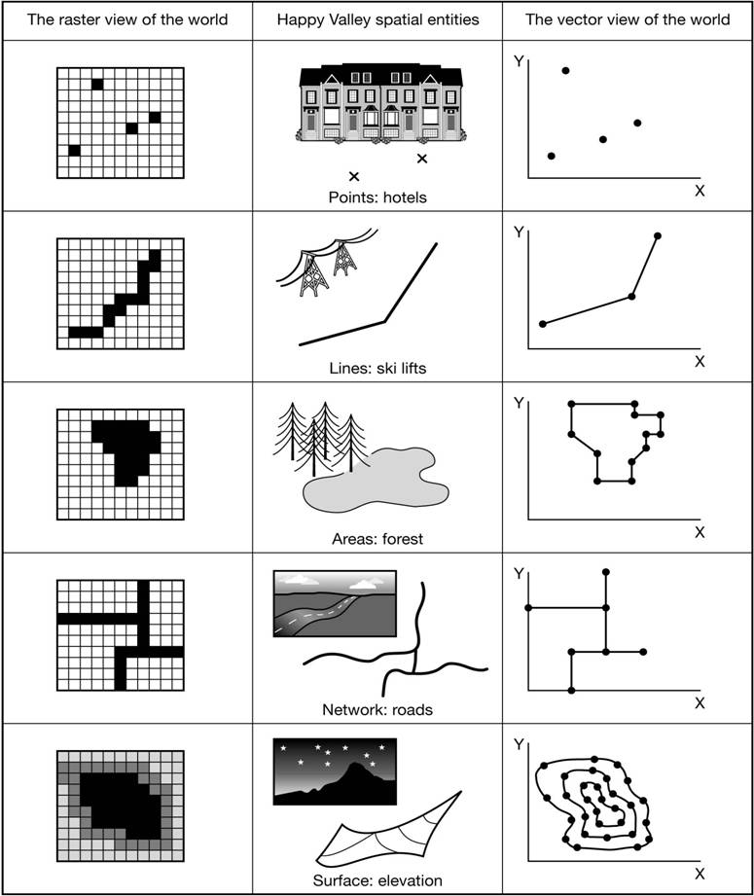
GIS
GIS works with digital information and represents the real world objects. There are two ways to store data :
  Raster
  Vector
University of Rhode Island
Oversize/Overweight Vehicle Routing and Permitting
with a Geographic Information System
Department of Civil and Environmental Engineering
Notes:
A raster data type is essentially any type of digital image displayed in the mesh.While a digital image refers to the output as a representation of reality , the raster data type will reflect an abstraction of reality.
Vector is the representations of interest focuses on the accuracy of locating the geographical space where the object are represented in discrete, defined limits.

Slide 15
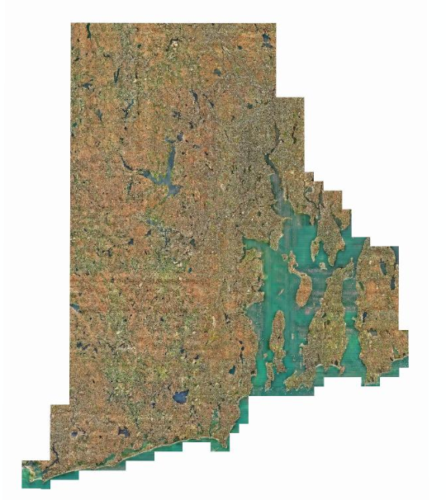
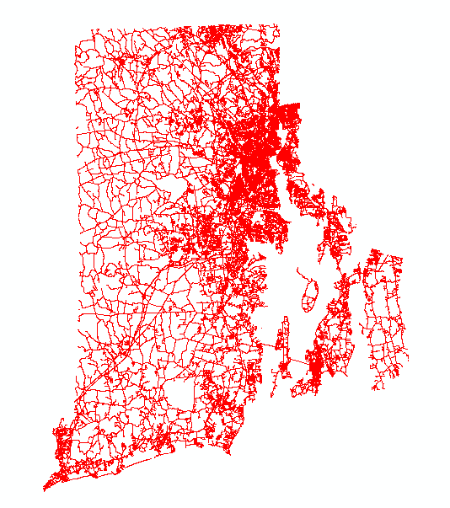
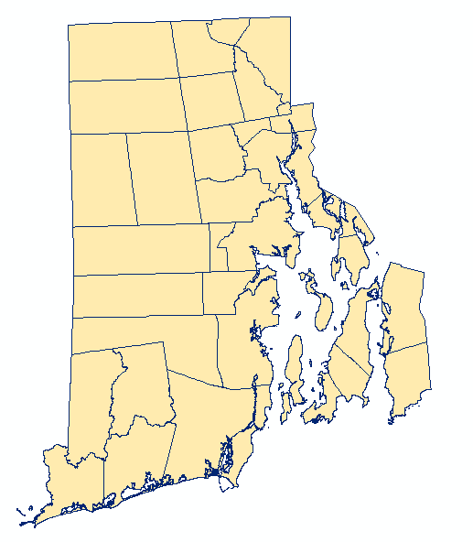
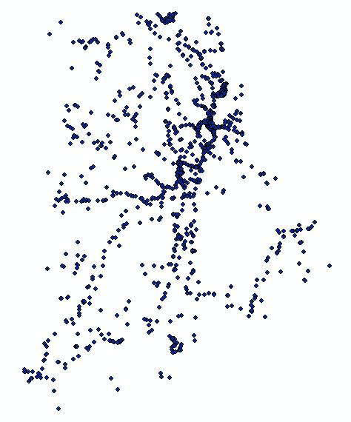
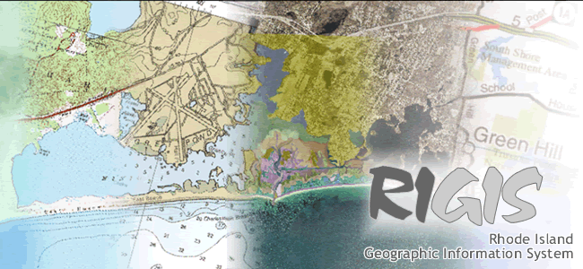
RIGIS
Source: http://www.edc.uri.edu/rigis/
University of Rhode Island
Oversize/Overweight Vehicle Routing and Permitting
with a Geographic Information System
Department of Civil and Environmental Engineering
Notes:
This system is composed by layer
1.The first layer is based Map of Rhode Island
The second layer is a bridge as blue point
The third layer is RI road
The fourth and final layer is a boundaries

Slide 16
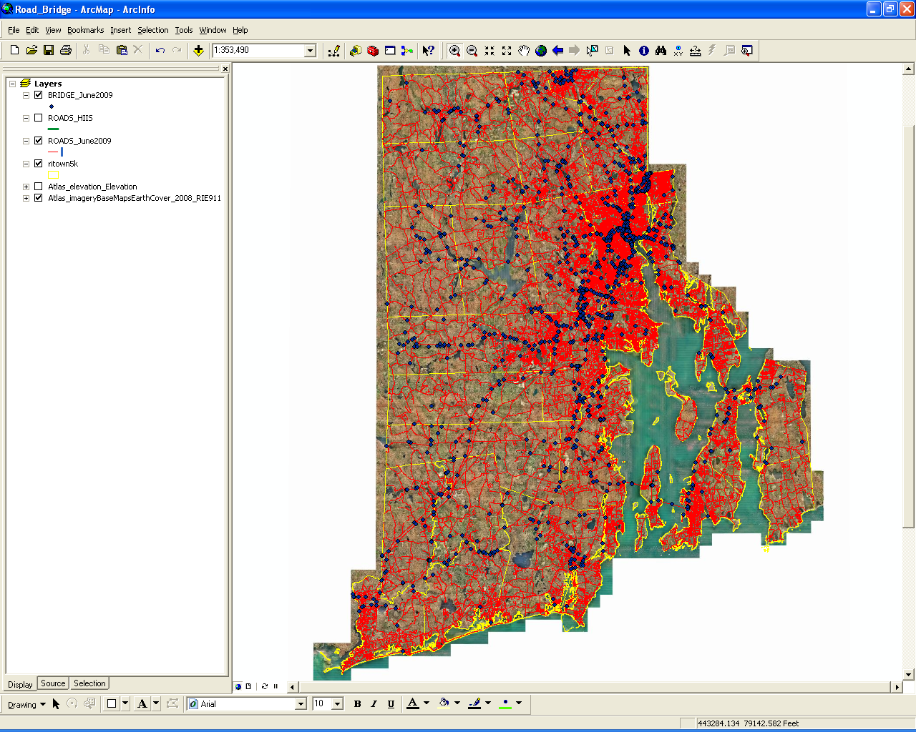
Road /bridge Network
Road / Bridge Network in GIS
University of Rhode Island
Oversize/Overweight Vehicle Routing and Permitting
with a Geographic Information System
Department of Civil and Environmental Engineering
Notes:
Asi se ven todas los layers juntos

Slide 17
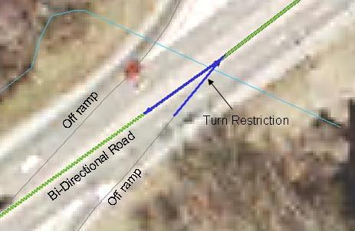
Network Properties
Network Properties (Roads)
  Road Connectivity
  One-way Roads
  Speed Limits
  Turn restrictions
  Address Locations
Source: The Use of a Geographic Information System for the Issuance of Oversize and Overweight Vehicle Permits
Mayrai Gindy & Andrew Prezioso
University of Rhode Island
Oversize/Overweight Vehicle Routing and Permitting
with a Geographic Information System
Department of Civil and Environmental Engineering
Notes:
Propiedas de las carreteras
-(Making the Network aware of the differences between intersections and bridge overpasses).
-(No U-Turns, and restrict turning movements at on and off ramp locations).
-(Each road segment has a range of addresses)

Slide 18
SDSS
Spatial Decision Support System
Is the combination of DSS and GIS functions which provides a natural platform for vehicle routing
  Minimizes time, cost and distance travel
  Uses short path or maximum capacity algorithm
University of Rhode Island
Oversize/Overweight Vehicle Routing and Permitting
with a Geographic Information System
Department of Civil and Environmental Engineering

Slide 19



BENEFITS
Reduce
  Time
  Personnel
  Human error
  Cost
University of Rhode Island
Oversize/Overweight Vehicle Routing and Permitting
with a Geographic Information System
Department of Civil and Environmental Engineering

Slide 20
Future
For this project:
  Allow for further development of new methods for routing OS/OW vehicles
  Provide a working model for other states to follow for routing OS/OW vehicles
University of Rhode Island
Oversize/Overweight Vehicle Routing and Permitting
with a Geographic Information System
Department of Civil and Environmental Engineering

Slide 21
Future
Expand the network from the sample route I295 to include all major routes in Rhode Island
Link network to structural analysis software for bridge loading capacity
Link network to RI.gov user interface
Program the output of the permit
for accept/reject and restrictions
University of Rhode Island
Oversize/Overweight Vehicle Routing and Permitting
with a Geographic Information System
Department of Civil and Environmental Engineering

Slide 22

Question ???
University of Rhode Island
Oversize/Overweight Vehicle Routing and Permitting
with a Geographic Information System
Department of Civil and Environmental Engineering

